Slide 1
Pension Fund with Risky Securities
Case 3: Cole Davis and Ryan Schmitt
MA 472G

Slide 2
Extension of Pension Fund
We can extend the concept of Case 2 of a simple pension fund with only a risk-free security.
Introducing risky securities can provide higher returns but also more volatility.

Slide 3
Goal
How can we maximize the return of a portfolio with three risky securities and a risk-free security while also minimizing risk?
Given certain assumptions, we can use the theory developed in Chapter 3 to complete this task.
The final goal is to have a pension fund that pays 50% of an ending salary for 20 years and grows at 2%.

Slide 4
Assumptions
Salary will grow at an annual rate of 2% for 40 years.
Pension payments will grow at an annual rate of 2% for 20 years.
Risk-free rate is set to be a constant annual return of 5%.
As a small investor, we will not be able to take a short position on any risky securities.
Capiński & Zasatawniak, pg. 89

Slide 5
Assumptions
Risky Security | Yearly Expected Return | Standard Deviation
A | 8% | 15%
B | 10% | 22%
C | 14% | 26%
Security Pair | Correlation
A - B | 0.5
A - C | -0.3
B - C | 0.3
Capiński & Zasatawniak, pg. 90

Slide 6
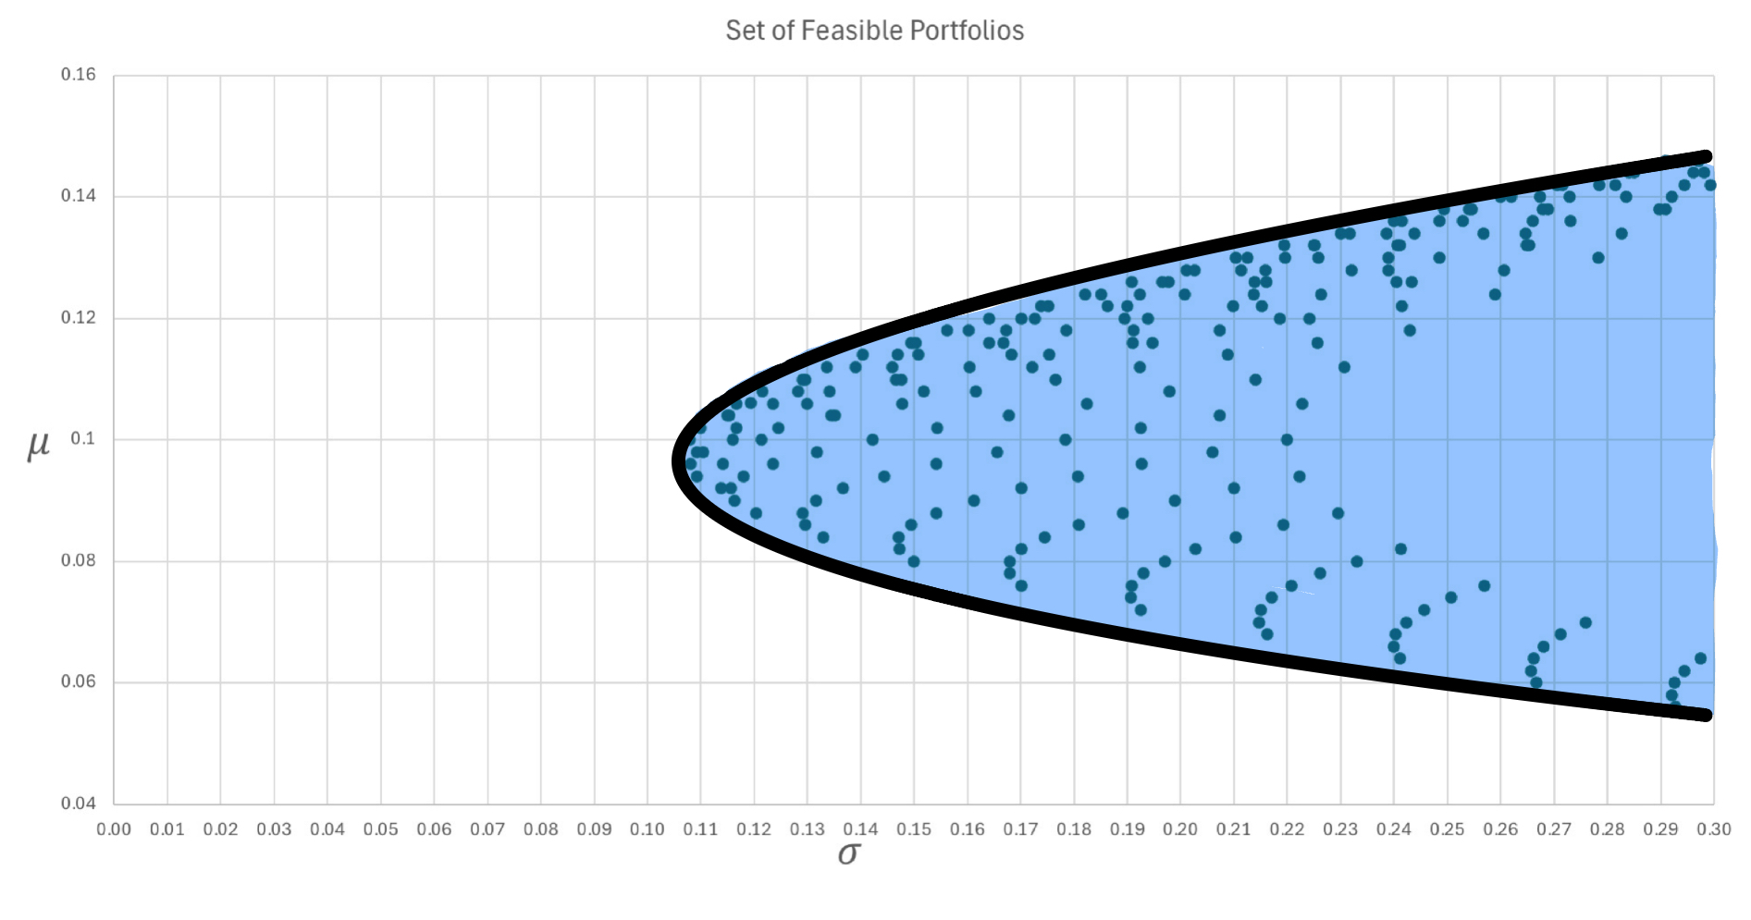
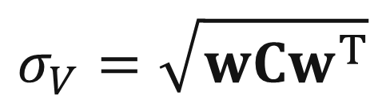

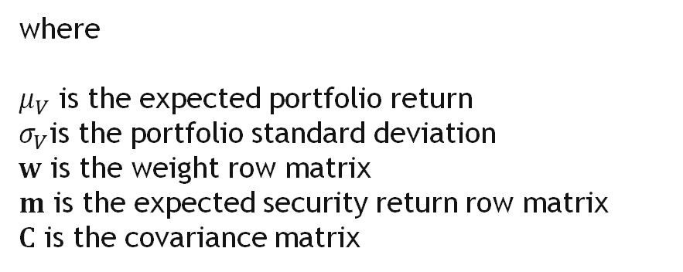
I - Process
Given the three risky securities A, B, and C, we can plot the set of all feasible portfolios on the risk-return plan using the following formulas:
$$μ_{V}=wm^{T}$$
$$σ_{V}=\sqrt{wCw^{T}}$$
where
$μ_{V}$ is the expected portfolio return
$σ_{V}$is the portfolio standard deviation
$w$ is the weight row matrix
$m$ is the expected security return row matrix
$C$ is the covariance matrix
Capiński & Zasatawniak, pg. 72

Slide 7
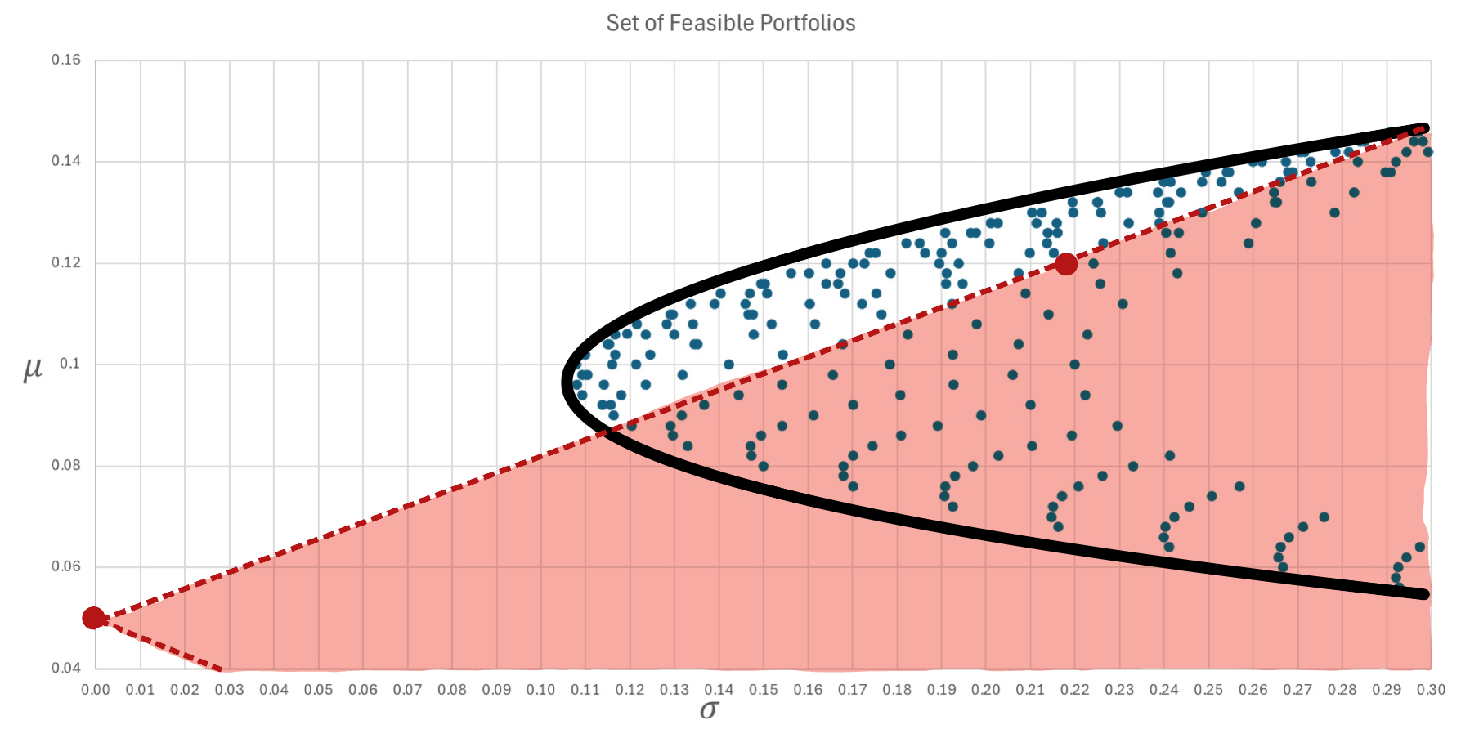
II - Process
By introducing a risk-free security, we can split our investment between the risk-free security and any feasible portfolio of the three risky securities to form a new portfolio.
The new set of feasible portfolios is highlighted to the right.

Slide 8
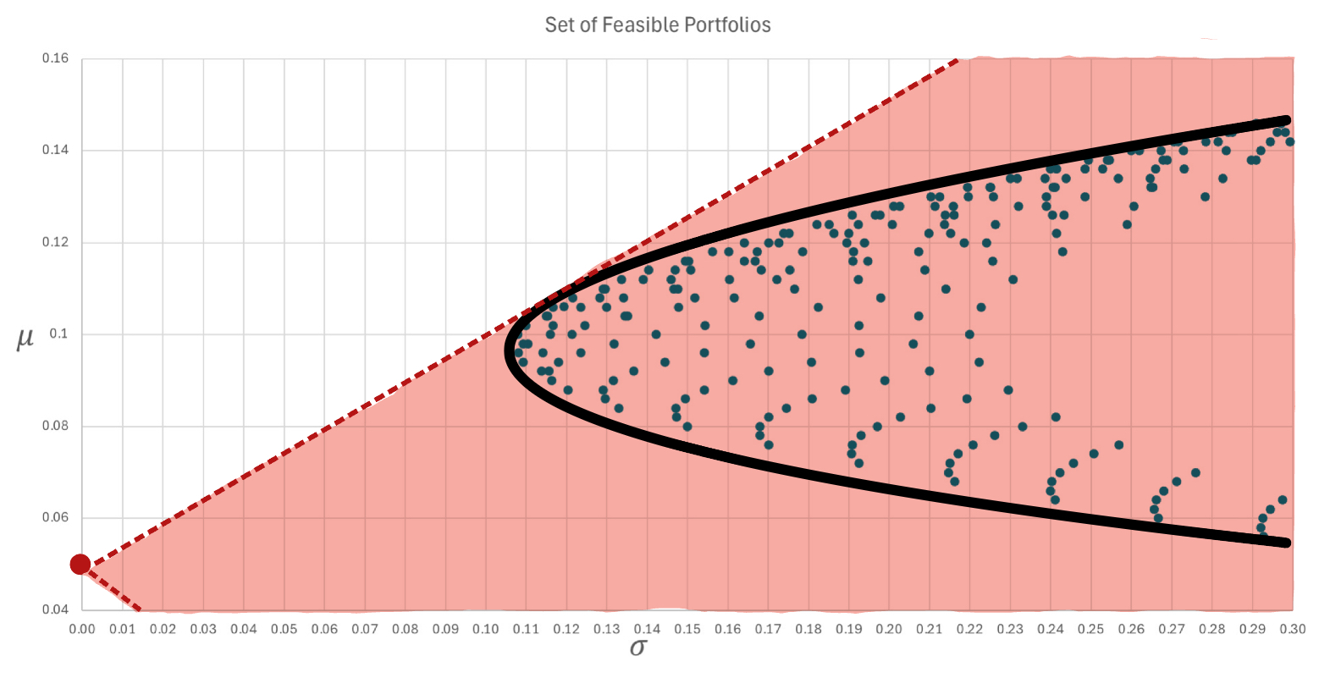
III - Process
A rational investor would want to maximize return while minimizing risk. To maximize return, we can pick a portfolio on the MVL and form a tangent line through that point and the risk-free security. This portfolio is the market portfolio, and the line is the Capital Market Line.
In other words, the CML has the greatest slope that passes through the risk-free security and a feasible portfolio.
The new set of feasible portfolios will look something like what is shown to the right.

Slide 9
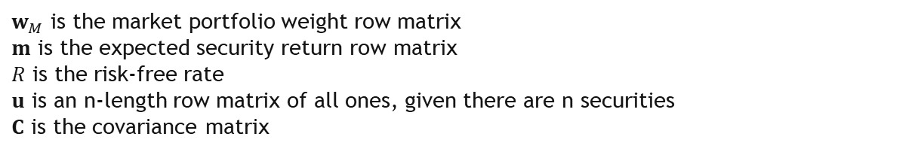
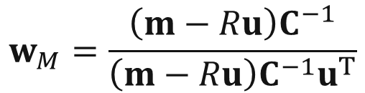
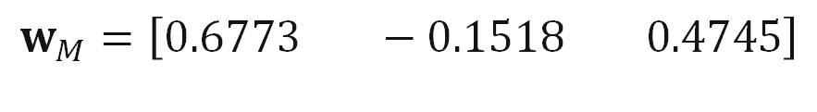
III - Process
We can use the following equation to compute the weights of the securities in the market portfolio:
$w_{M}$ is the market portfolio weight row matrix
$m$ is the expected security return row matrix
$R$ is the risk-free rate
$u$ is an n-length row matrix of all ones, given there are n securities
$C$ is the covariance matrix
$$w_{M}=\frac{\left(m−Ru\right)C^{−1}}{{\left(m−Ru\right)C}^{−1}u^{T}}$$
where
With the given data, Excel was used to compute the weights of the market portfolio as:
$$w_{M}=\left[0.6773 −0.1518 0.4745\right]$$
Capiński & Zasatawniak, pg. 83

Slide 10
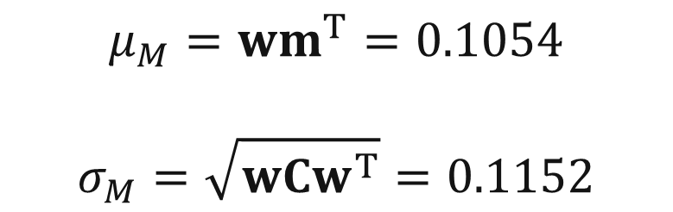
III - Process
Once the weights of the market portfolio are known, we can use the equations introduced earlier to compute the market portfolio’s expected return and standard deviation. We can then plot the market portfolio on the risk-return plane and form the Capital Market Line.
With the given data, Excel was used to compute the expected return and standard deviation of the market portfolio as:
$$μ_{M}=wm^{T}=0.1054$$
$$σ_{M}=\sqrt{wCw^{T}}=0.1152$$

Slide 11
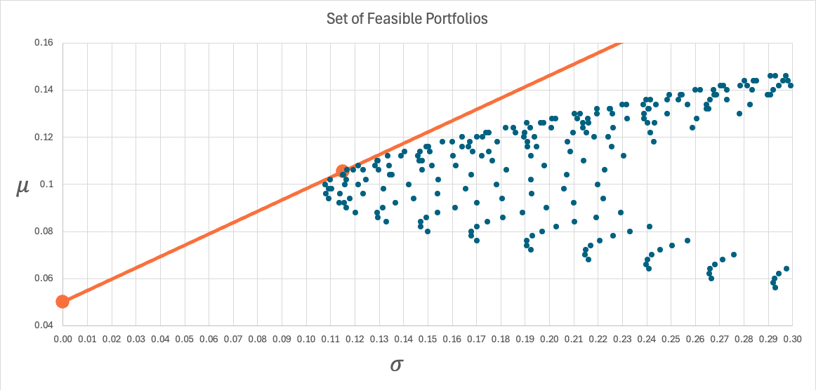

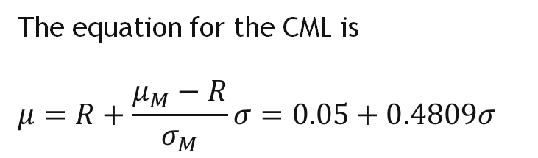
IV - Process
Given that the market portfolio has point $\left({σ_{M},μ}_{M}\right)=\left(0.1152, 0.1054\right),$ we can plot the market portfolio on the risk-return plane and form the CML.
The equation for the CML is
$$μ=R+\frac{μ_{M}−R}{σ_{M}}σ=0.05+0.4809σ$$
Using the CML, we can determine the return rate of a portfolio with a mix of the market portfolio and the risk-free security given a certain risk level.
Capiński & Zasatawniak, pg. 84

Slide 12
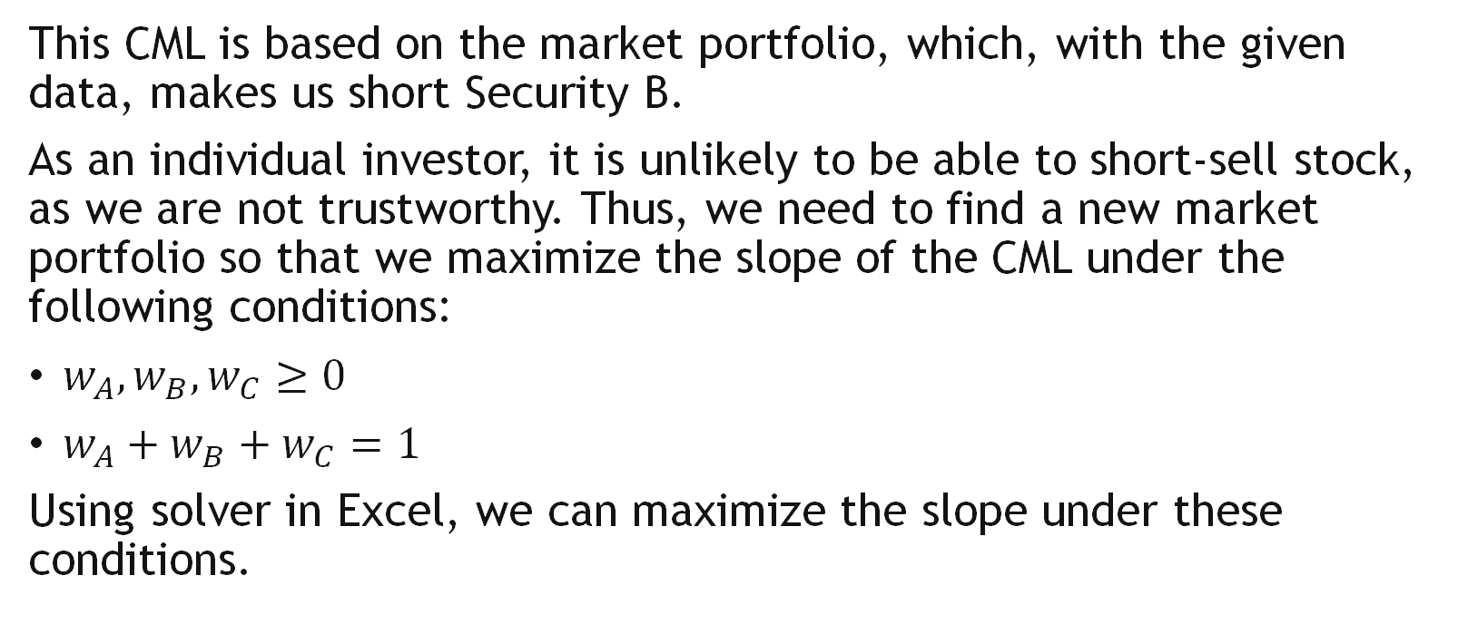
V - Process
This CML is based on the market portfolio, which, with the given data, makes us short Security B.
As an individual investor, it is unlikely to be able to short-sell stock, as we are not trustworthy. Thus, we need to find a new market portfolio so that we maximize the slope of the CML under the following conditions:
$w_{A}, w_{B}, w_{C}≥0$
$w_{A}+w_{B}+w_{C}=1$
Using solver in Excel, we can maximize the slope under these conditions.

Slide 13



V - Process
Let $M^{′}$ denote the new market portfolio. Maximizing $\frac{μ_{M^{′}} − R}{σ_{M^{′}}},$ which is the slope of the new CML, subject to the constraints given earlier, we obtain the following weights:
$$w_{M^{′}}=\left[0.5646 0.0 0.4354\right]$$
With these weights, we can find the expected return and standard deviation of $M^{′}:$
$$μ_{M^{′}}=wm^{T}=0.1061$$
$$σ_{M^{′}}=\sqrt{wCw^{T}}=0.1193$$

Slide 14
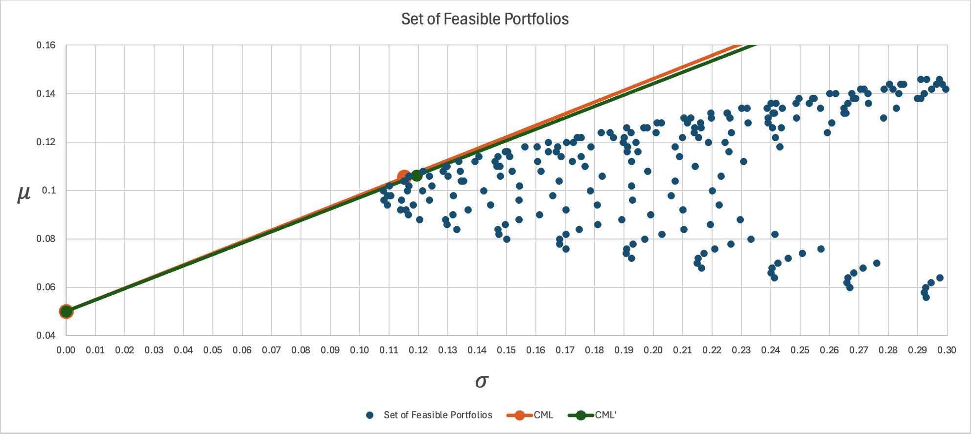
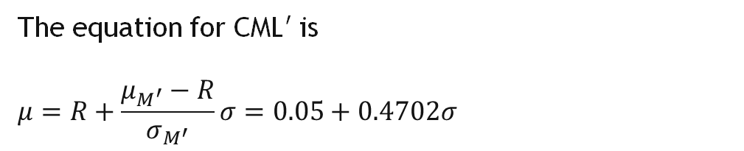

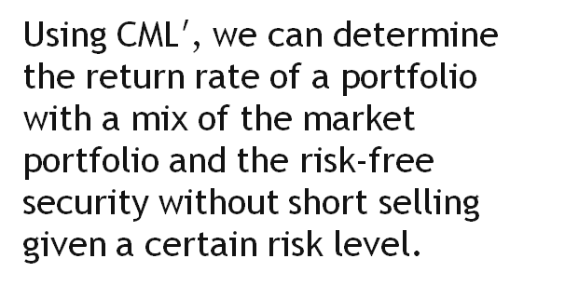
VI - Process
Given that the new market portfolio has point $\left({σ_{M^{′}},μ}_{M^{′}}\right)=\left(0.1193, 0.1061\right),$ we can plot $M^{′}$ on the risk-return plane and form the new CML, or CML$′$.
The equation for CML$′$ is
$$μ=R+\frac{μ_{M^{′}}−R}{σ_{M^{′}}}σ=0.05+0.4702σ$$
Using CML$′$, we can determine the return rate of a portfolio with a mix of the market portfolio and the risk-free security without short selling given a certain risk level.

Slide 15
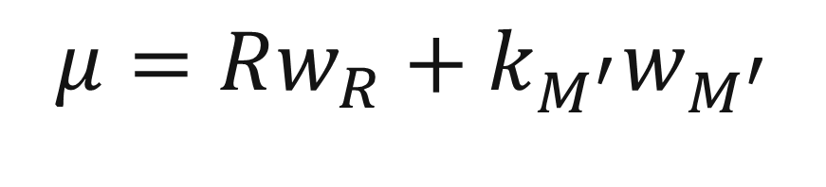

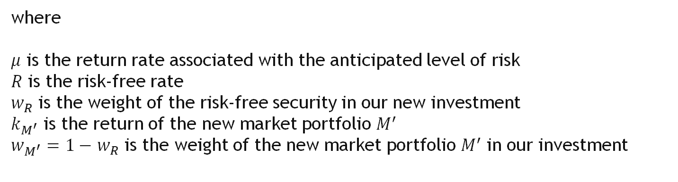
VII - Process
Given the level of risk we wish to take on, we can find the expected return using the equation for CML$′$. Once the expected return is known, we can find the percentage of our investment that we need to invest in the risk-free asset and $M^{′}$ using the following equation:
$$μ=Rw_{R}+k_{M^{′}}w_{M^{′}}$$
where
$μ$ is the return rate associated with the anticipated level of risk
$R$ is the risk-free rate
$w_{R}$ is the weight of the risk-free security in our new investment
$k_{M^{′}}$ is the return of the new market portfolio $M^{′}$
$w_{M^{′}}=1−$ $w_{R}$ is the weight of the new market portfolio $M^{′}$ in our investment

Slide 16
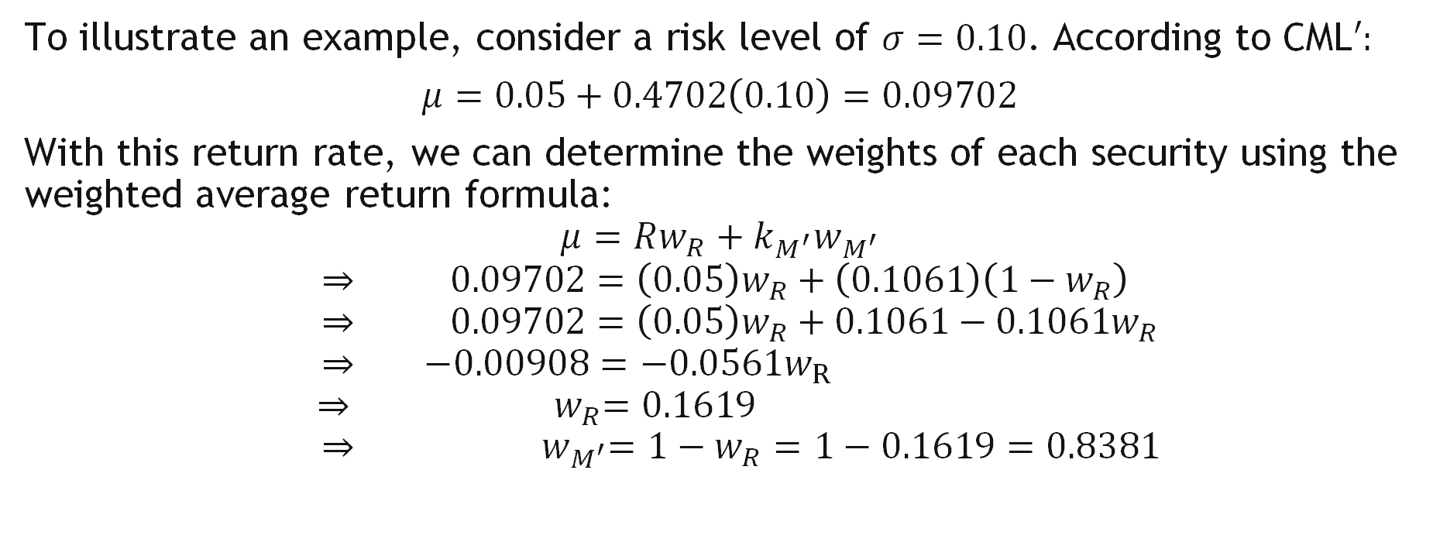
VII - Process
To illustrate an example, consider a risk level of $σ=0.10$. According to CML$′:$
$μ=0.05+0.4702\left(0.10\right)=0.09702$
With this return rate, we can determine the weights of each security using the weighted average return formula:
$$μ=Rw_{R}+k_{M^{′}}w_{M^{′}}$$
$$⇒ 0.09702=\left(0.05\right)w_{R}+\left(0.1061\right)\left(1−w_{R}\right)$$
$$⇒ 0.09702=\left(0.05\right)w_{R}+0.1061−0.1061w_{R}$$
$$⇒ −0.00908=−0.0561w_{R}$$
$⇒{ w}_{R}=0.1619$
$$⇒{ w}_{M^{′}}=1−w_{R}=1−0.1619=0.8381$$

Slide 17
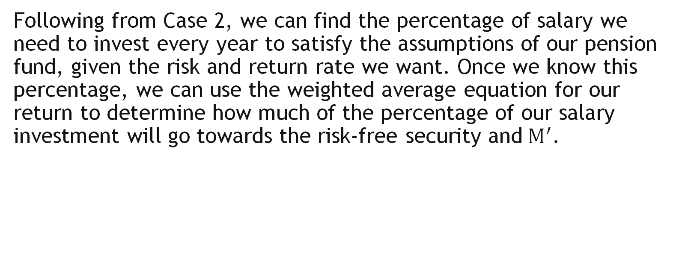
VII - Process
Following from Case 2, we can find the percentage of salary we need to invest every year to satisfy the assumptions of our pension fund, given the risk and return rate we want. Once we know this percentage, we can use the weighted average equation for our return to determine how much of the percentage of our salary investment will go towards the risk-free security and$M^{′}$.

Slide 18
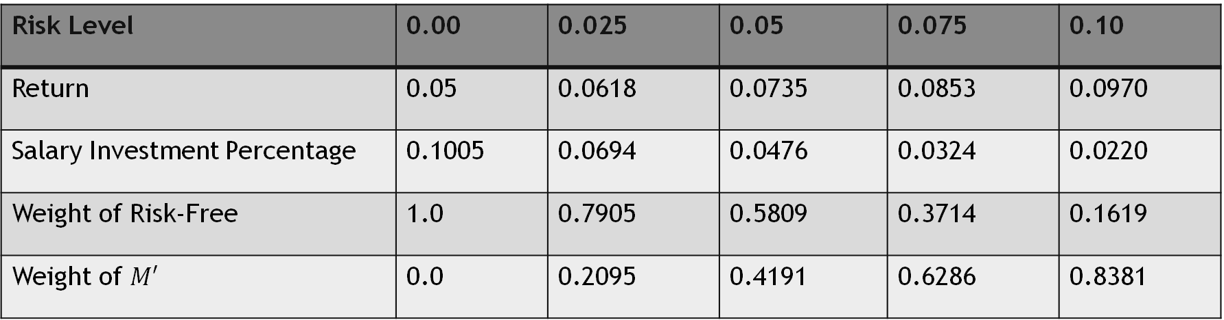

VII - Process
The following table shows the Salary Investment Percentage, Weight of risk-free security, and weight of $M′$ based on the chosen risk level and return:
Risk Level | 0.00 | 0.025 | 0.05 | 0.075 | 0.10
Return | 0.05 | 0.0618 | 0.0735 | 0.0853 | 0.0970
Salary Investment Percentage | 0.1005 | 0.0694 | 0.0476 | 0.0324 | 0.0220
Weight of Risk-Free | 1.0 | 0.7905 | 0.5809 | 0.3714 | 0.1619
Weight of $M′$ | 0.0 | 0.2095 | 0.4191 | 0.6286 | 0.8381

Slide 19
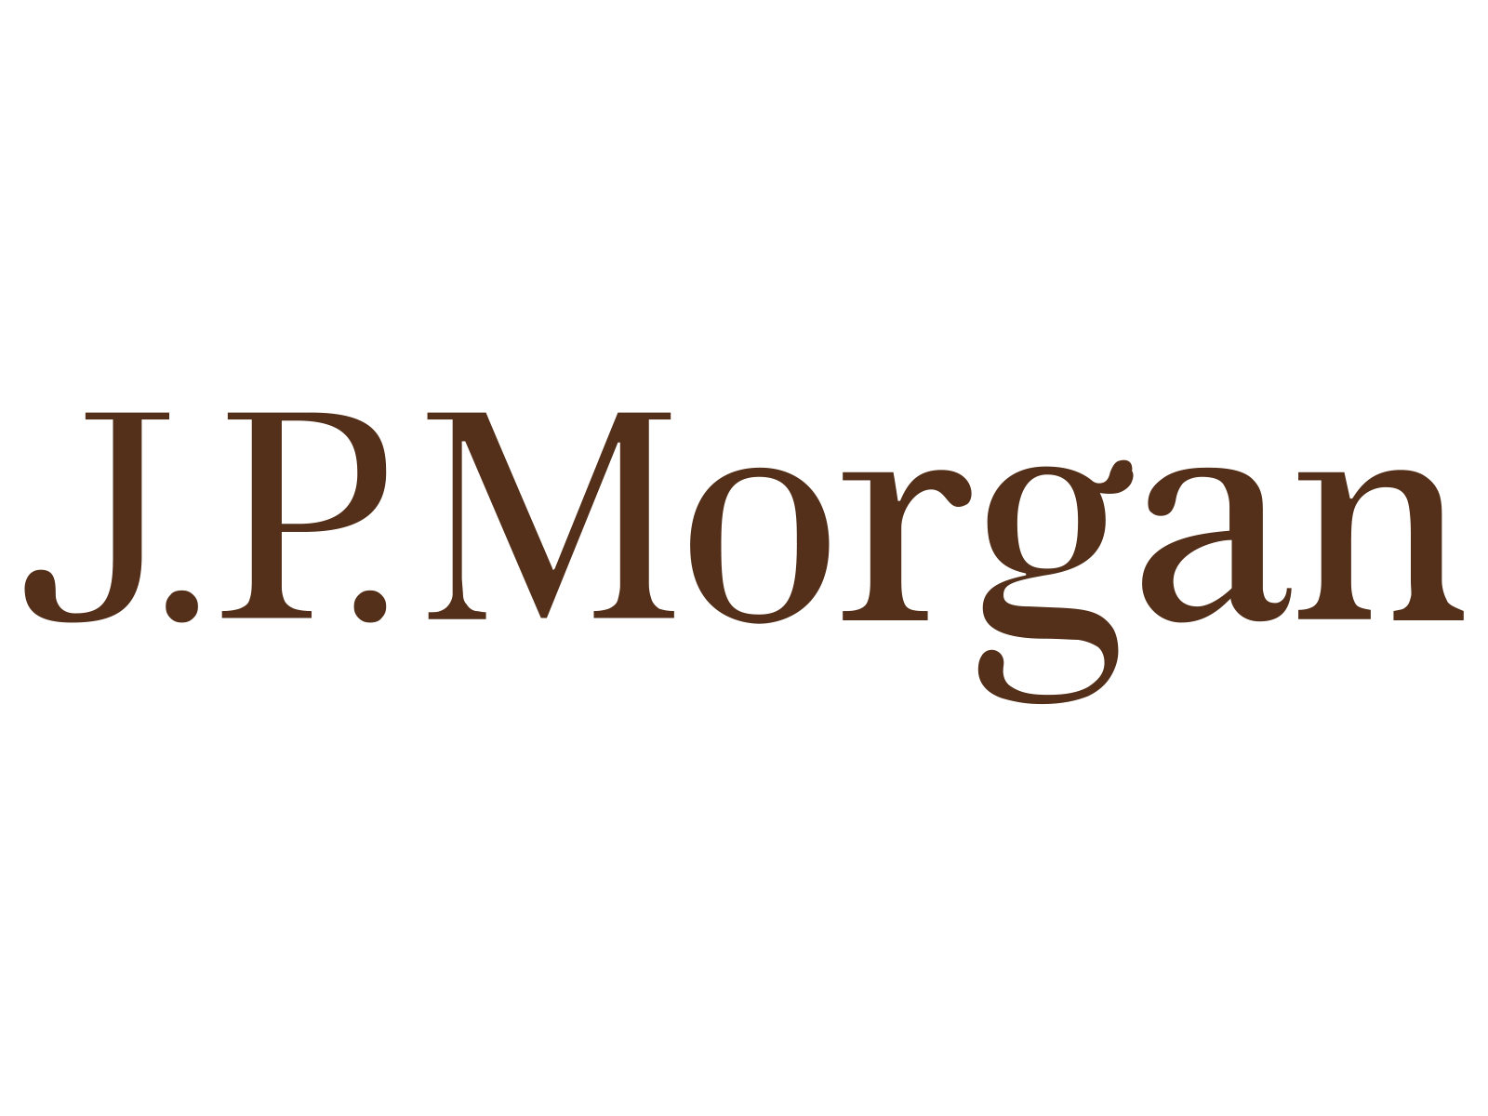


Real World Financial Data

Slide 20
Assumptions
Risk-free rate is set to be a constant annual return of 4.29%, which is equal to the current 10-year Treasury Yield.
As a small investor, we will not be able to take a short position on any risky securities.
We need the expected return and standard deviation for each of our stocks, but they aren’t explicitly given.
We can use the “=STOCKHISTORY” function in Excel to pull historical stock prices for each of our stocks to complete our assumptions.
https://www.cnbc.com/quotes/US10Y

Slide 21
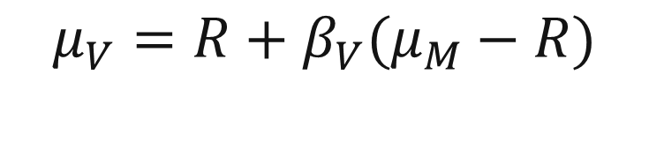

Assumptions
To obtain the expected returns for each of our stocks, we can use the CAPM model. This equation is stated as follows:
where
$μ_{V}$ is the expected return of the stock
$R$ is the risk-free rate
$β_{V}$ is the Beta of our stock
$μ_{M}$ is the expected return of the market
$$μ_{V}=R+β_{V}(μ_{M}−R)$$
We simply need to determine the Beta for each stock and the expected market return rate.
Capiński & Zasatawniak, pg. 87

Slide 22
Assumptions
To determine the Beta for each stock, we can run a regression on the historical monthly return rates of the market and the stock in question. To model the market return rates, we can find the monthly return rates of the S&P 500 Index. The Beta for our stock is equal to the regression coefficient. The results for each of the Stocks is shown below.
To get to expected market return rate, we can simply take an average of the monthly return rates and multiply our result by 12. The result is an expected market return rate of 8.55%
AAPL | JPM | KO
1.2442 | 1.1903 | 0.5251

Slide 23
Assumptions
Risky Security | Expected Annual Return | Standard Deviation
Apple | 9.45% | 8.96%
J.P Morgan | 9.23% | 7.77%
Coco-Cola Co | 6.47% | 4.52%
Correlation Matrix | Apple | J.P Morgan | Coco-Cola Co
Apple | 1 | 0.2414 | 0.2644
J.P Morgan | 0.2414 | 1 | 0.3085
Coco-Cola Co | 0.2644 | 0.3085 | 1

Slide 24
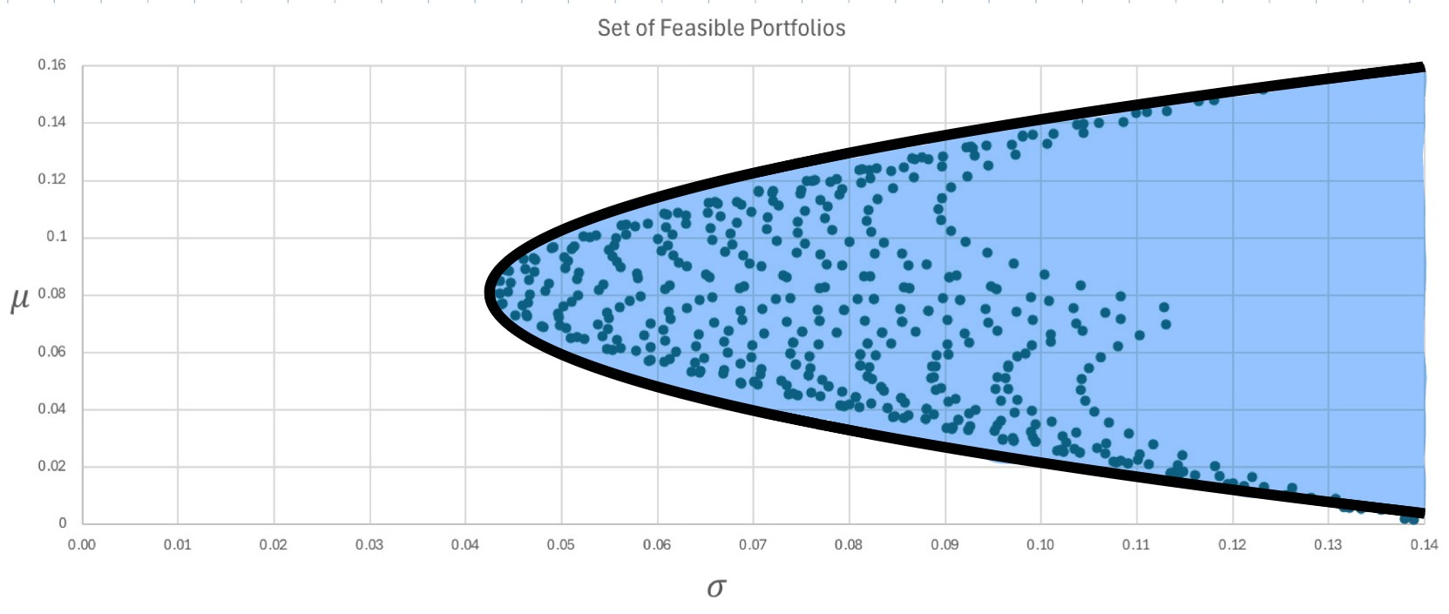


I - Process
Given the newly identified three risky securities, we can plot the set of all feasible portfolios on the risk-return plan using the following formulas:
$$μ_{V}=wm^{T}$$
$$σ_{V}=\sqrt{wCw^{T}}$$
where
$μ_{V}$ is the expected portfolio return
$σ_{V}$is the portfolio standard deviation
$w$ is the weight row matrix
$m$ is the expected security return row matrix
$C$ is the covariance matrix
Capiński & Zasatawniak, pg. 72

Slide 25
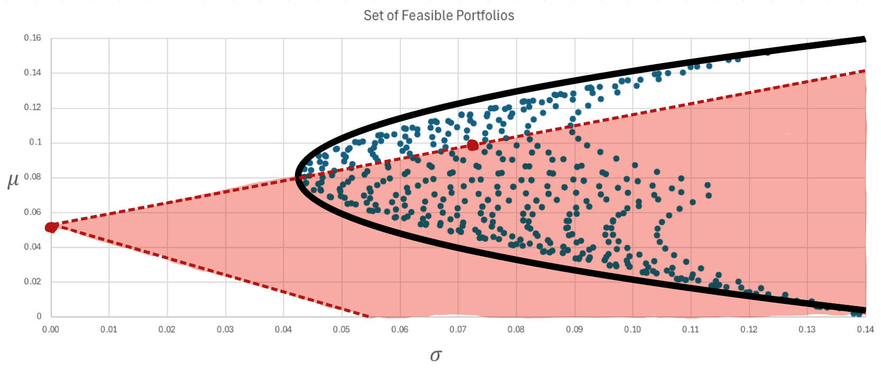
II - Process
By introducing a risk-free security, we can split our investment between the risk-free security and our three chosen risky securities to form a new portfolio.
The new set of feasible portfolios is highlighted to the right.

Slide 26
III - Process
Here we will take the same approach, as we will want to choose a portfolio that will maximize returns while minimizing risk. This means that we will again choose the market portfolio, which is the point of tangency of the set of feasible portfolios and the line with the greatest slope that passes through the risk-free security.

Slide 27
III - Process
We can use the following equation to compute the weights of the portfolio of the market portfolio:
$w_{M}$ is the market portfolio weight row matrix
$m$ is the expected security return row matrix
$R$ is the risk-free rate
$u$ is an n-length row matrix of all ones, given there are n securities
$C$ is the covariance matrix
$$w_{M}=\frac{\left(m−Ru\right)C^{−1}}{{\left(m−Ru\right)C}^{−1}u^{T}}$$
where
With the new data, Excel was used to compute the weights of the market portfolio as:
$$w_{M}=\left[0.2860 0.3841 0.3280\right]$$
Capiński & Zasatawniak, pg. 83

Slide 28
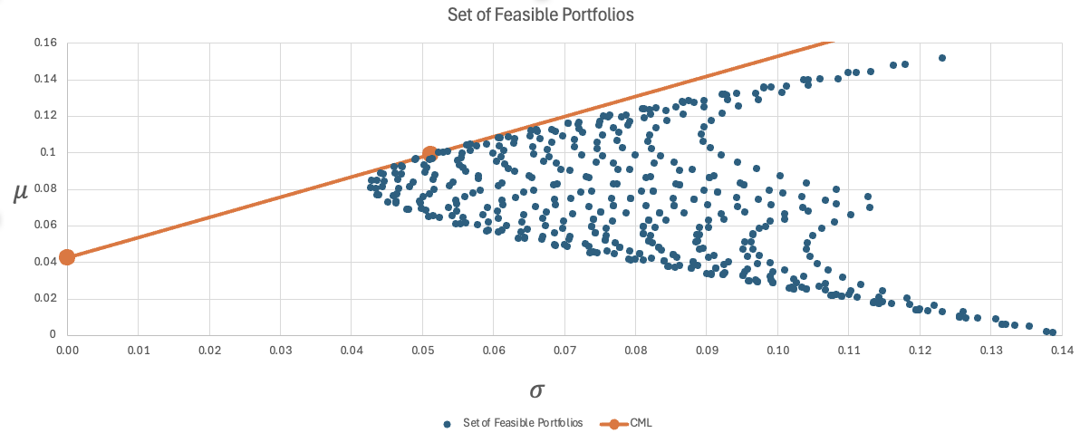
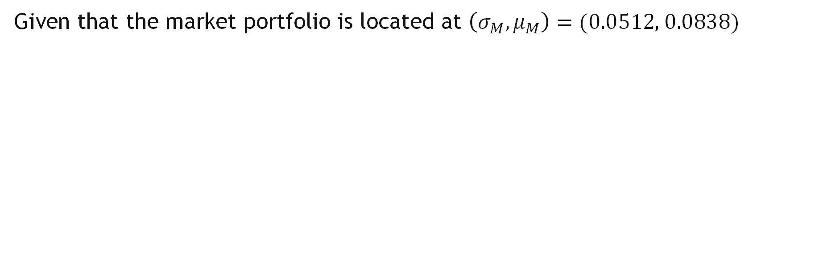
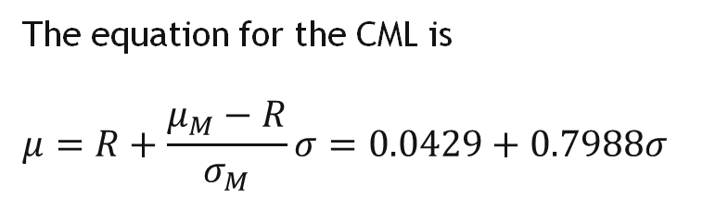
VI - Process
Given that the market portfolio is located at $\left({σ_{M}, μ}_{M}\right)=(\text{0.0512, 0.0838)}$
The equation for the CML is
$$μ=R+\frac{μ_{M}−R}{σ_{M}}σ=0.0429+0.7988σ$$
Here we have the CML line with its associated market portfolio

Slide 29
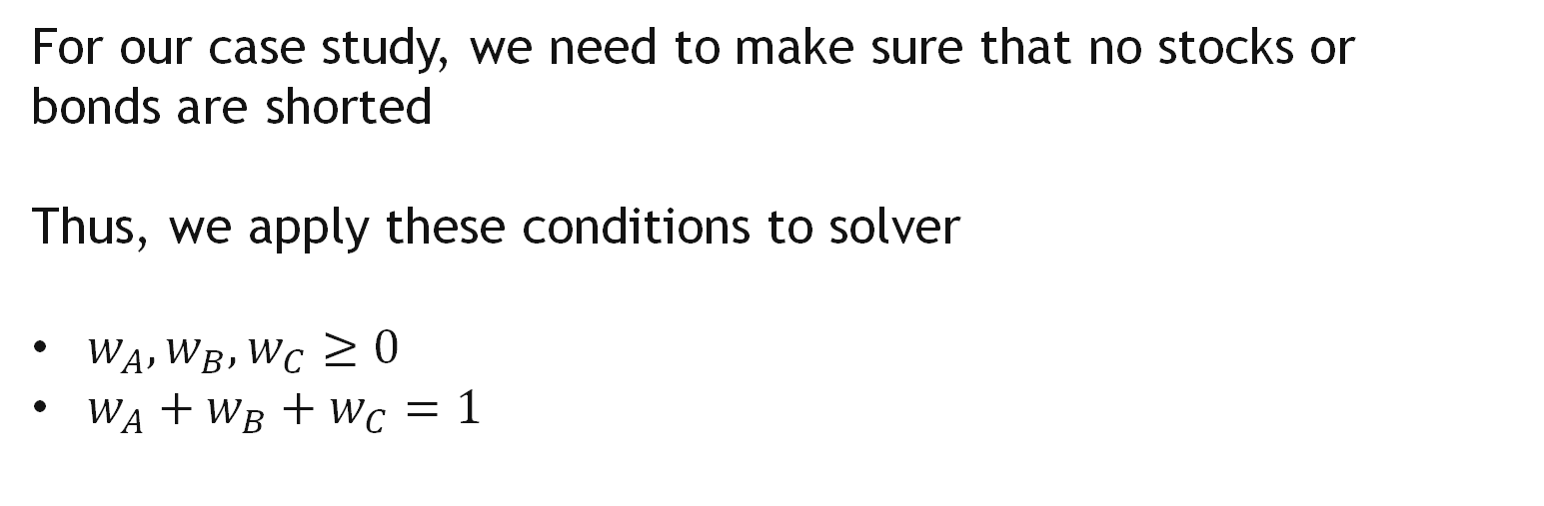

V – Assumptions Application
For our case study, we need to make sure that no stocks or bonds are shorted
Thus, we apply these conditions to solver
$w_{A}, w_{B}, w_{C}≥0$
$w_{A}+w_{B}+w_{C}=1$
$$w_{A}=0.2868$$
$w_{B}=0.3852$
$$w_{C}=0.3280$$
$$w_{A}+w_{B}+w_{C}= 1$$
$$\left(σ_{M},μ_{M}\right)= (0.0513, 0.0839)$$

Slide 30
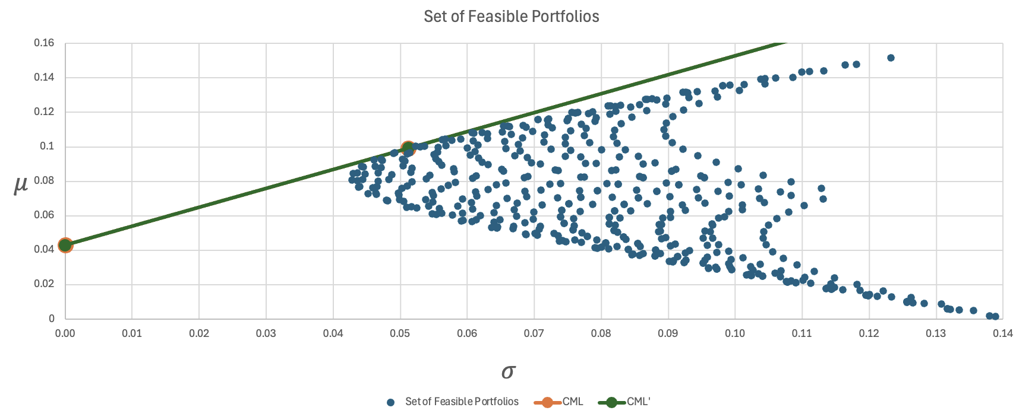
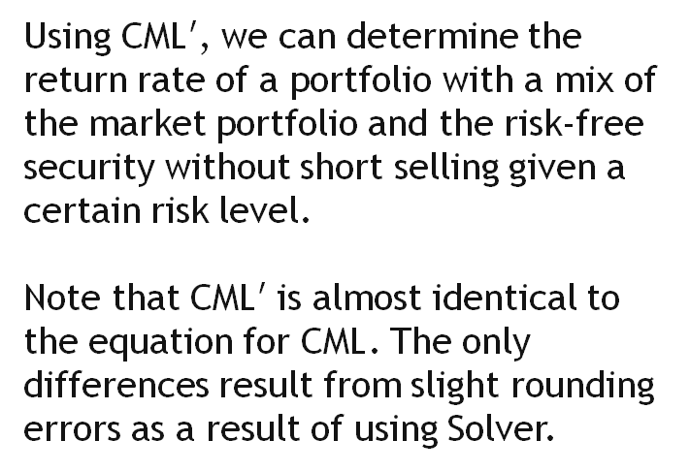
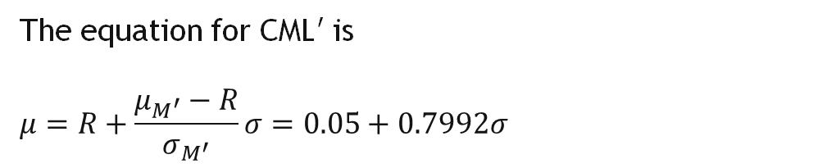
VI - Process
The equation for CML$′$ is
$$μ=R+\frac{μ_{M^{′}}−R}{σ_{M^{′}}}σ=0.05+0.7992σ$$
Using CML$′$, we can determine the return rate of a portfolio with a mix of the market portfolio and the risk-free security without short selling given a certain risk level.
Note that CML$′$ is almost identical to the equation for CML. The only differences result from slight rounding errors as a result of using Solver.
This is expected since our original market portfolio did not short any stock to begin with.

Slide 31
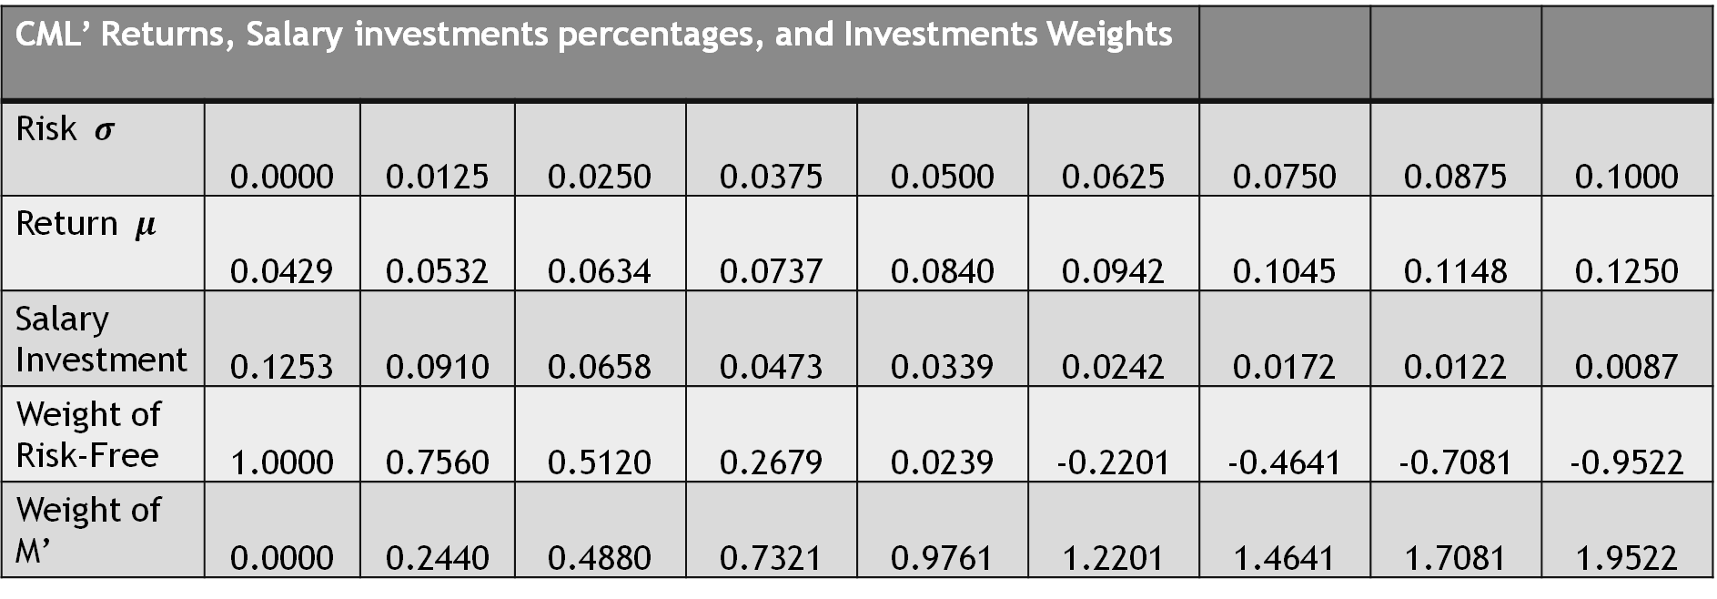
Conclusion
CML’ Returns, Salary investments percentages, and Investments Weights
Risk $σ$ | 0.0000 | 0.0125 | 0.0250 | 0.0375 | 0.0500 | 0.0625 | 0.0750 | 0.0875 | 0.1000
Return $μ$ | 0.0429 | 0.0532 | 0.0634 | 0.0737 | 0.0840 | 0.0942 | 0.1045 | 0.1148 | 0.1250
Salary Investment | 0.1253 | 0.0910 | 0.0658 | 0.0473 | 0.0339 | 0.0242 | 0.0172 | 0.0122 | 0.0087
Weight of Risk-Free | 1.0000 | 0.7560 | 0.5120 | 0.2679 | 0.0239 | -0.2201 | -0.4641 | -0.7081 | -0.9522
Weight of M’ | 0.0000 | 0.2440 | 0.4880 | 0.7321 | 0.9761 | 1.2201 | 1.4641 | 1.7081 | 1.9522

Slide 32
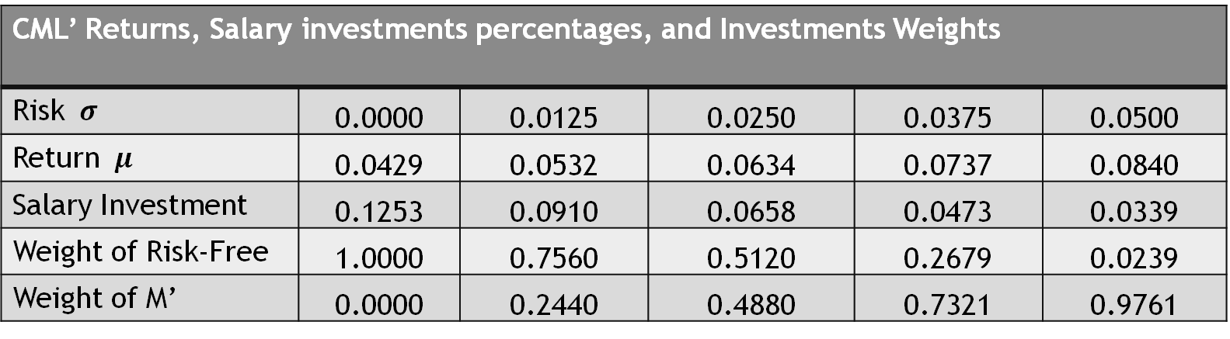
Conclusion
CML’ Returns, Salary investments percentages, and Investments Weights
Risk $σ$ | 0.0000 | 0.0125 | 0.0250 | 0.0375 | 0.0500
Return $μ$ | 0.0429 | 0.0532 | 0.0634 | 0.0737 | 0.0840
Salary Investment | 0.1253 | 0.0910 | 0.0658 | 0.0473 | 0.0339
Weight of Risk-Free | 1.0000 | 0.7560 | 0.5120 | 0.2679 | 0.0239
Weight of M’ | 0.0000 | 0.2440 | 0.4880 | 0.7321 | 0.9761

Slide 33
References
Capiński, M., & Zastawniak, T. (2011). Mathematics for Finance: An Introduction to Financial Engineering (Second Edition). Springer.
CNBC. (n.d.). US10Y: U.S. 10 year Treasury - stock price, quote and news. CNBC. https://www.cnbc.com/quotes/US10Y

